Slide 1

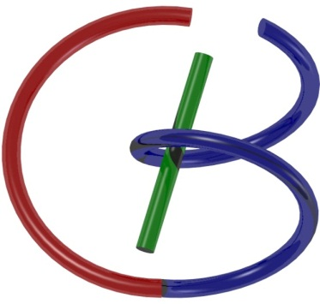



38655 BMED-2300-02
Lecture 3: System
Ge Wang, PhD
Biomedical Imaging Center
CBIS/BME, RPI
wangg6@rpi.edu
January 23, 2018
Key to Master
Nice to Know

Slide 2
BB Schedule for S18
Tue | Topic | Fri | Topic
1/16 | Introduction | 1/19 | MatLab I (Basics)
1/23 | System | 1/26 | Convolution
1/30 | Fourier Series | 2/02 | Fourier Transform
2/06 | Signal Processing | 2/09 | Discrete FT & FFT
2/13 | MatLab II (Homework) | 2/16 | Network
2/20 | No Class | 2/23 | Exam I
2/27 | Quality & Performance | 3/02 | X-ray & Radiography
3/06 | CT Reconstruction | 3/09 | CT Scanner
3/20 | MatLab III (CT) | 3/23 | Nuclear Physics
3/27 | PET & SPECT | 3/30 | MRI I
4/03 | Exam II | 4/06 | MRI II
4/10 | MRI III | 4/13 | Ultrasound I
4/17 | Ultrasound II | 4/20 | Optical Imaging
4/24 | Machine Learning | 4/27 | Exam III
Office Hour: Ge Tue & Fri 3-4 @ CBIS 3209 | wangg6@rpi.edu
Kathleen Mon 4-5 & Thurs 4-5 @ JEC 7045 | chens18@rpi.edu

Slide 3
Syllabus Spring 2018
Grading:
The final grade in this course will be based on the student total score on all components of the course. The total score is broken down into the following components:
Class participation: 10%
Exam I: 20%
Exam II: 20%
Exam III: 20%
Homework: 30%

Slide 4
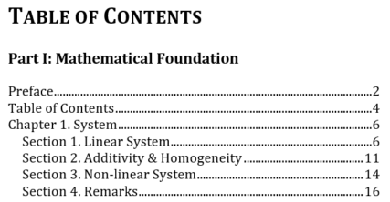
Outline

Slide 5
Function vs System
http://www.thefreedictionary.com/mathematical+function
Function – A mathematical relation such that each element of a given set (the domain of the function) is associated with an element of another set (the range of the function)
System – A group of interacting, interrelated, or interdependent elements forming a complex whole:
a. An organism as a whole,
b. A group of physiologically related parts,
c. A group of interacting physical components,
d. A network of structures and channels

Slide 6
Function
Domain
Map
Range

Slide 7
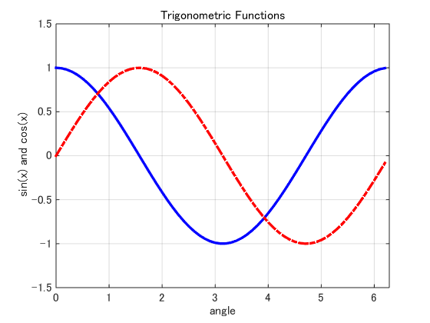
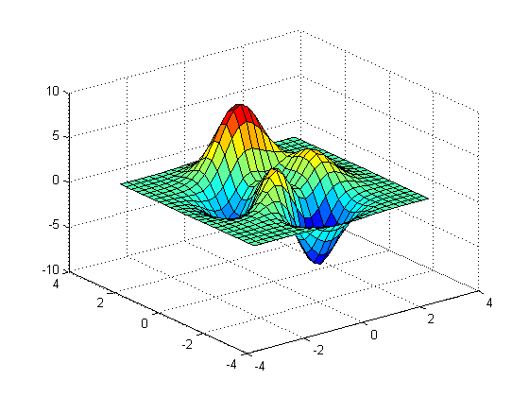
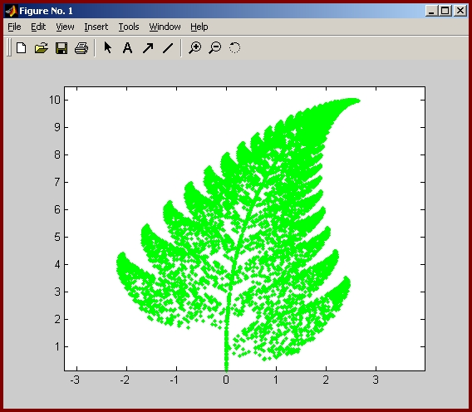
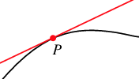
Examples

Slide 8
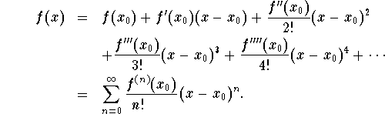
Taylor Expansion

Slide 9
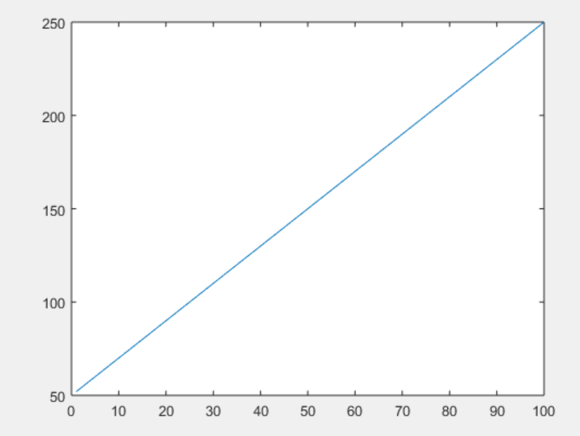
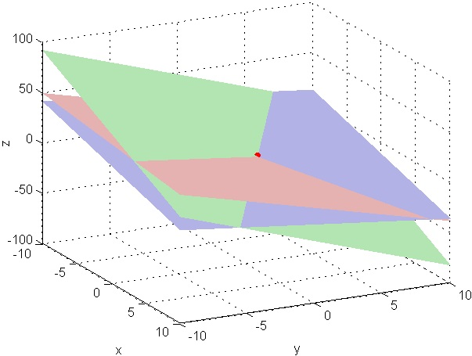
Linear Function

Slide 10
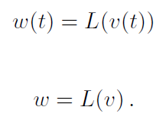
System
Input v
Output w
System
Operator L

Slide 11
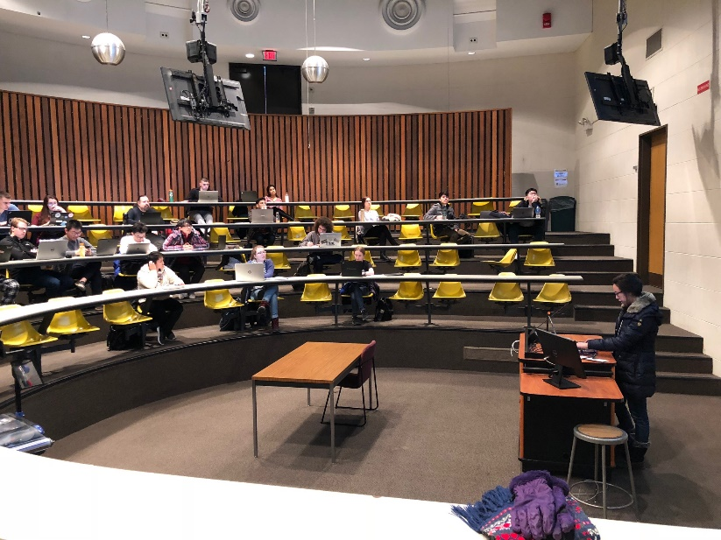

Measurement System
Variable
System
Signal
Reference
You are measuring teaching quality
Modifier

Slide 12
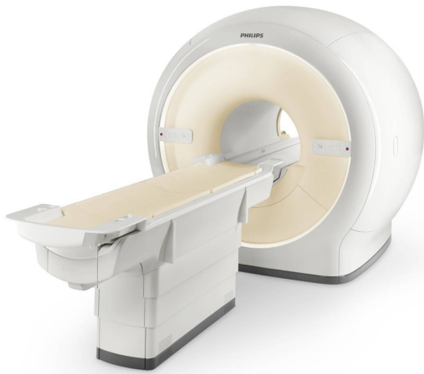
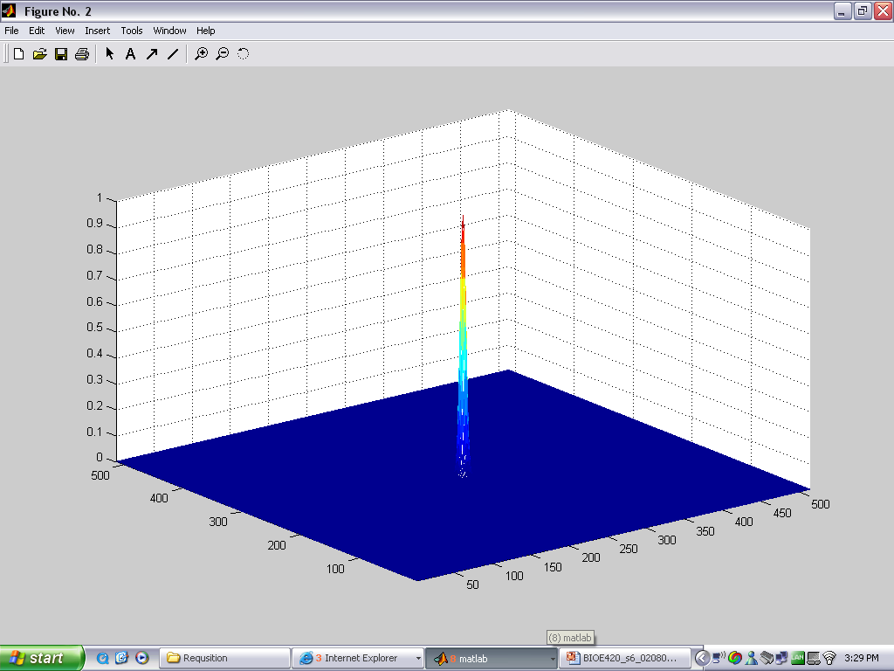
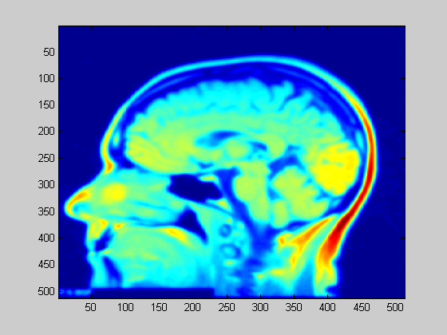
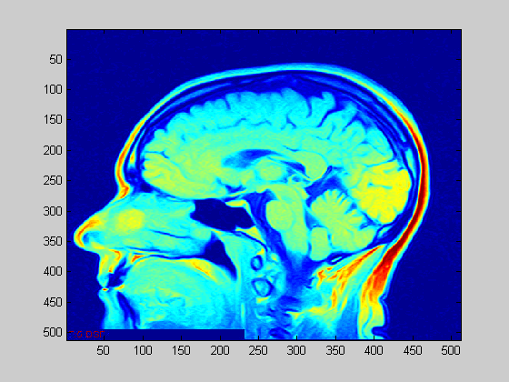
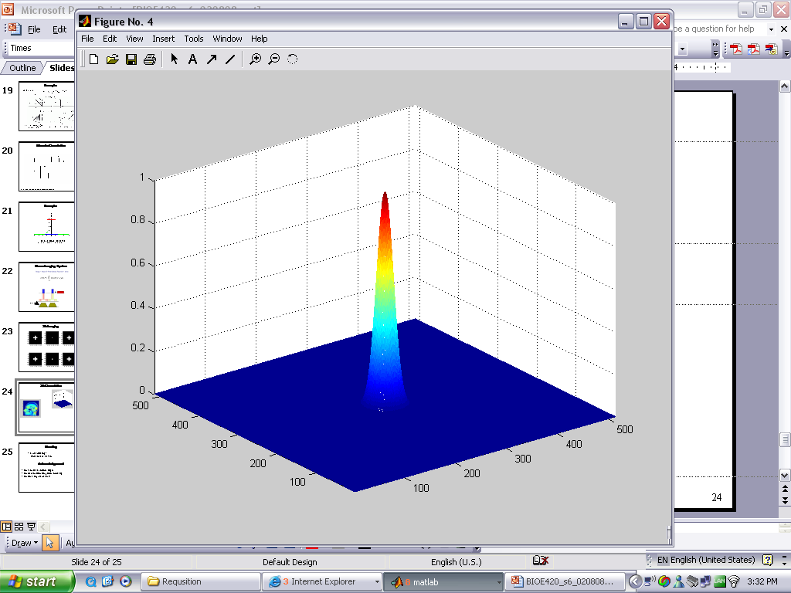
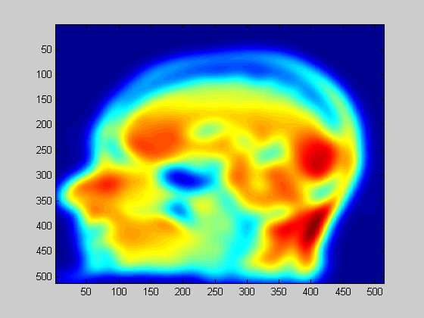
Imaging System
System 1
Output 1
Input
System 2
Output 2

Slide 13
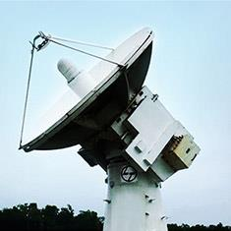
Control System
Input
Output
System L
Feedback

Slide 14
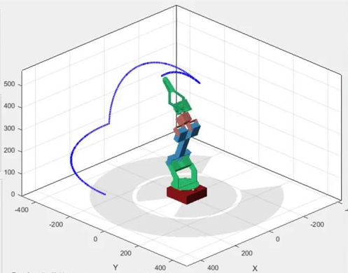
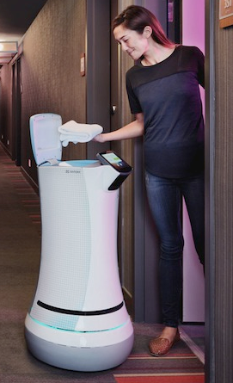
Robotic System

Slide 15
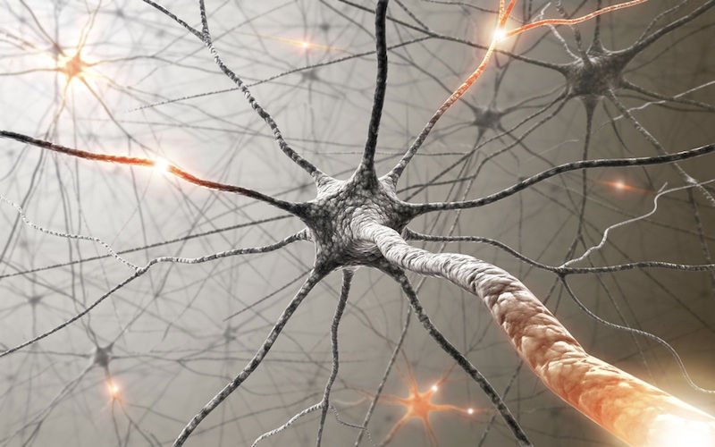
Neurological System

Slide 16

Human System

Slide 17
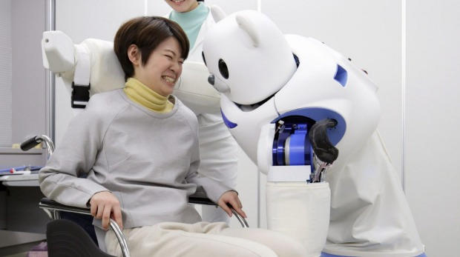

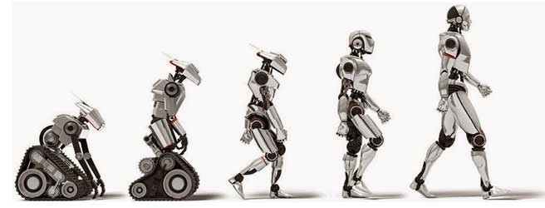
Robot & Human

Slide 18
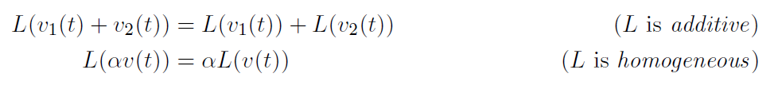
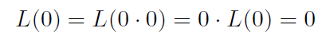
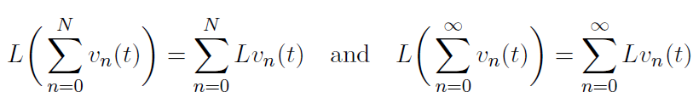
Linear System
Input v
Output L(v)
System L
Scalar α
If a system is linear, L(0) = 0; for example L(v(t)) = v(t) + 1 is not linear. Why?

Slide 19

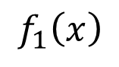
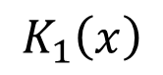
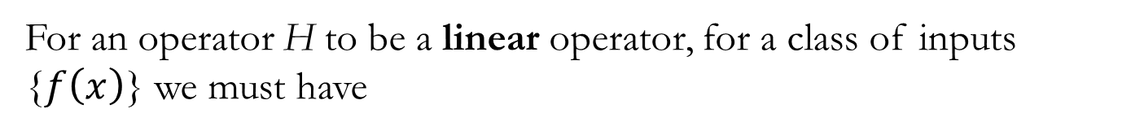

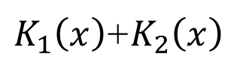
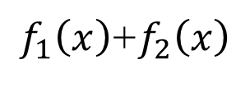

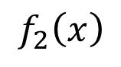
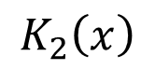
Additivity
For an operator H to be a linear operator, for a class of inputs {$f\left(x\right)$} we must have
$$f_{1}\left(x\right)$$
$$H\left[f_{1}\left(x\right)\right]$$
$$K_{1}\left(x\right)$$
+
$$f_{2}\left(x\right)$$
$$H\left[f_{2}\left(x\right)\right]$$
$$K_{2}\left(x\right)$$
$f_{1}\left(x\right)$+$f_{2}\left(x\right)$
=
$K_{1}\left(x\right)$+$K_{2}\left(x\right)$
$$H\left[f_{1}\left(x\right)+f_{2}\left(x\right)\right]$$
Adapted from Xavier Intes’ PPT

Slide 20
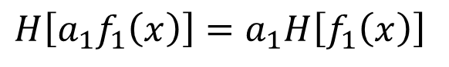
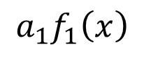
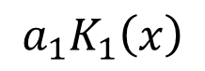
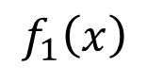
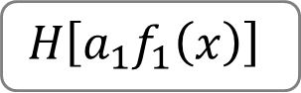
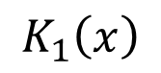

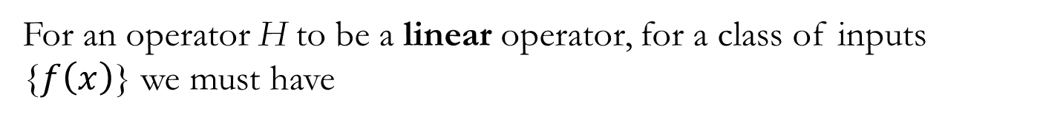
Homogeneity
For an operator H to be a linear operator, for a class of inputs {$f\left(x\right)$} we must have
$$f_{1}\left(x\right)$$
$$H\left[f_{1}\left(x\right)\right]$$
$$K_{1}\left(x\right)$$
$${a_{1}f}_{1}\left(x\right)$$
$$H\left[a_{1}f_{1}\left(x\right)\right]$$
$${a_{1}K}_{1}\left(x\right)$$
$$H\left[{a_{1}f}_{1}\left(x\right)\right]=a_{1}H\left[f_{1}\left(x\right)\right]$$
Adapted from Xavier Intes’ PPT

Slide 21
Quiz: Linear or Not?
System L

Slide 22
Additivity & Homogeneity
Additivity
Homogeneity
Additivity
Homogeneity

Slide 23
Equivalence in the Continuous Case
Additivity
Homogeneity

Slide 24
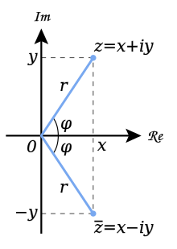
Independence of Homogeneity
Additivity
Homogeneity
To my best knowledge, it remains a challenge to construct such a counter-example for a real scalar. I would appreciate any information on this topic.

Slide 25
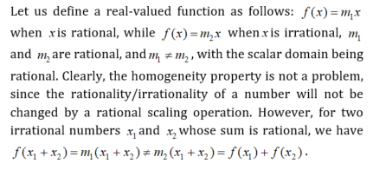
Independence of Additivity
Additivity
Homogeneity

Slide 26
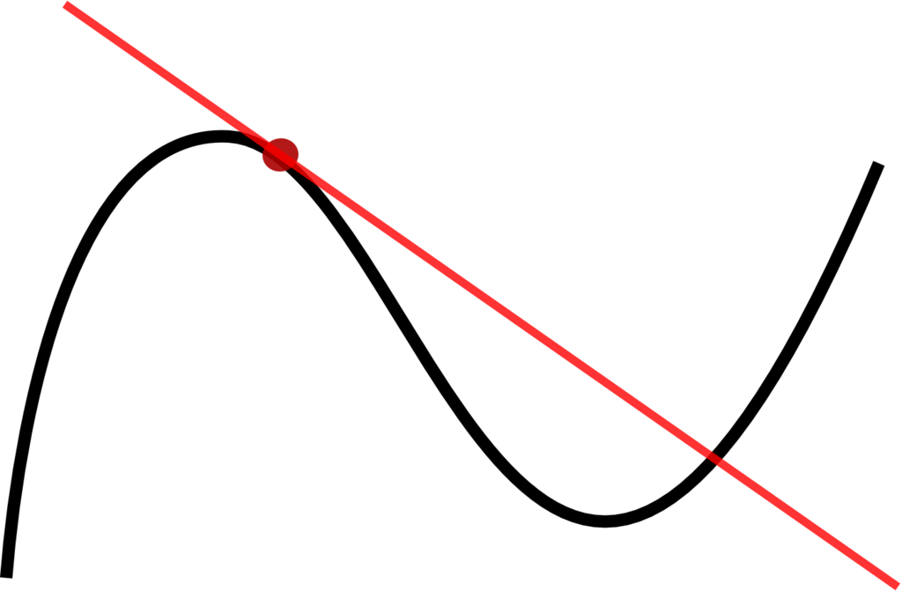
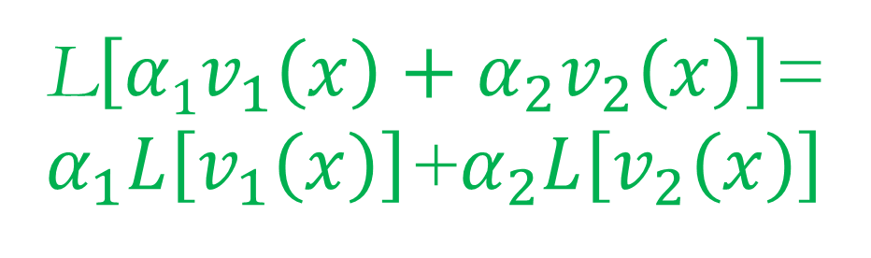
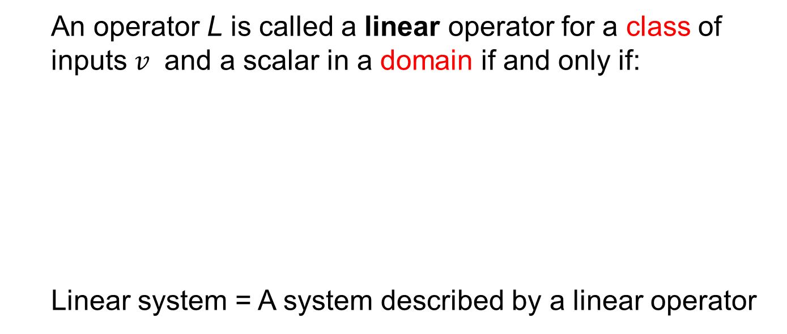
Recap!
An operator L is called a linear operator for a class of inputs $v$ and a scalar in a domain if and only if:
Linear system = A system described by a linear operator
L$\left[{α1v}_{1}\left(x\right)+α_{2}v_{2}\left(x\right)\right]$=
$α_{1}L\left[v_{1}\left(x\right)\right]$+$α_{2}L\left[v_{2}\left(x\right)\right]$

Slide 27


Relative Linearity
The apparent discrepancy between the linear system and linear function concepts can be eliminated by considering the system responses in terms of relative changes. Given a status of a system as defined by its input-output relationship in a specific coordinate system, let us look at changes in the input and the resultant changes in the output of the system. Then, the linear system can be re-defined:
$$Δy1\left(t\right)=L\left[{Δx}_{1}\left(t\right)\right] and Δy2(t)=L\left[{Δx}_{2}\left(t\right)\right]$$
$$αΔy1\left(t\right)+β{Δy}_{2}\left(t\right)=L\left[{αΔx}_{1}\left(t\right)+β{Δx}_{2}\left(t\right)\right]$$

Slide 28
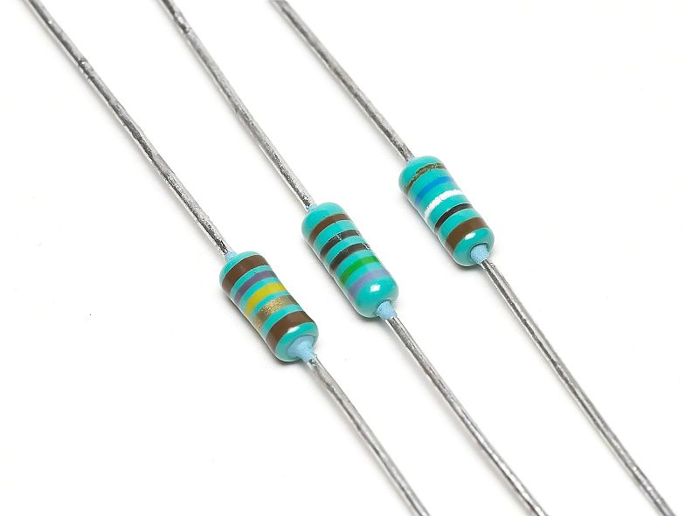
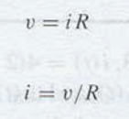
V-I Relationship for Resistor

Slide 29
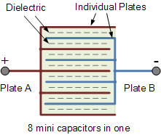
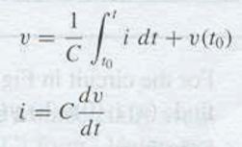
V-I Relationship for Capacitor

Slide 30
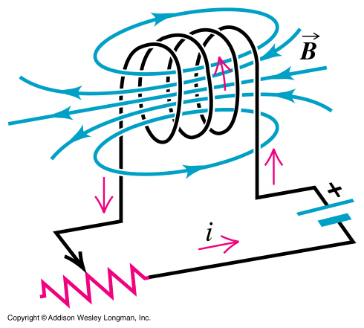


V-I Relationship for Inductor

Slide 31


Shift-Invariant Linear System
Input v(t)
Output w(t)
System L
Input v(t-τ)
Output w(t-τ)
System L

Slide 32


Slide 33




Slide 34

Shift Invariability

Slide 35


Non-linear System
Nonlinear equations are difficult to analyze but can be numerically solved. New phenomena are inherent in many nonlinear systems, such as
Chaos
Solitons
Singularities
which are counterintuitive and/or unpredictable.

Slide 36

Logistic Map
The system status (a number in the simplest case) will evolve in discrete steps according to
One explanation:
x – Normalized population (0,1);
r – Growth rate

Slide 37

Chaotic Behavior
>>
N = 200;
x0 = 0.001;
for r = 2.5:0.005:4.0
x = zeros(1,N);
x(1) = x0;
for n = 1:N-1
x(n+1) = r .* x(n) .* (1.0 - x(n));
end;
xstate = x(100:N);
rval = xstate;
rval(:) = r;
plot(rval,xstate,'bo','MarkerSize',1);xlim([2.5 4.0]);ylim([0 1]);hold on;
end;
>>
http://www.sharetechnote.com/html/Handbook_EngMath_Chaos_LogisticEq.html

Slide 38
Biological & Artificial Neurons
Branches (Dendrite)
Body (Soma)
Interface (Synapsis)
Fiber (Axon)
Input
Output
Biological Neuron
Summation (Linear)
Weight
Transformation (Nonlinear)
Input
Output
Artificial Neuron

Slide 39

Deep Neural Network (DNN)
https://www.strong.io/blog/deep-neural-networks-go-to-the-movies

Slide 40

Class Project?

Slide 41
Homework for BB-03
Please give an example of a shift-invariant linear system and show that it satisfies the requirements.
Please give an example of a linear system and show that it satisfies additivity and homogeneity but it is not shift-invariant.
Please give an example of a nonlinear system that satisfies neither additivity and homogeneity.
Due date: One week from now (by midnight next Tue). Please upload your MS word report to MLS.

